Slide 1
SIGNED INTEGERS

Slide 2
Signed integers
There are 2 ways of representing signed integers: i.e. Sign Magnitude Format and Complement format.
In the Sign Magnitude Format the leftmost bit/MSB represents the sign.
A negative number is represented by a 1 and a positive number by a 0.
The range of integers that can be expressed in a group of 8 bits is from – (2⁷ – 1) to (2⁷ – 1)
In general a d bit binary sign magnitude representation in which the first bit represents the sign has a range of – (2^{d-1} – 1) to + (2^{d-1} – 1).

Slide 3
SIGNED INTEGERS
To add two sign magnitude numbers, we follow the usual addition rule
If the sign differs we subtract the smaller number from the larger number and give the result the sign of the larger number.
If the signs are the same we add them and we give the result the same sign.

Slide 4
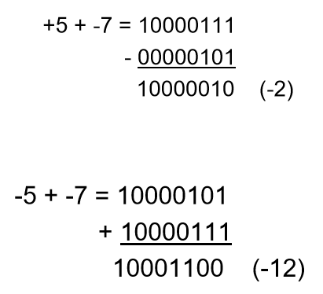
SIGNED INTEGERS

Slide 5
SIGNED INTEGERS 2’S Complement
The d digit 2’s complement of a d bit binary integer N is equal to 2^{d} – N where the subtraction is done in binary.
The eight bit 2’s complement of an 8 bit binary number 00000101 is 100000000 – 00000101 = 11111011
The 2’s complement may also be computed by applying the following rules. Invert the bit values; the result is called one’s complement then add 1 e.g.
for N = 00000101 Invert 11111010 + 1 = 11111011

Slide 6
2’S Complement
17₁₀ = 00010001 Invert the bits and add 1 11101110 + 1 = 11101111 = -17
119₁₀= 00010001 Invert the bits and add 1; 10001000 + 1 =10001001 = -119
N.B
Note the difference between the sign magnitude representation and the 2’s complement representation.

Slide 7
Rules to convert to decimal
If a number is positive (beginning with a 0), convert it to base 10 directly as usual.
If it is negative (begins with 1) get its 2’s complement and convert it to base 10.
e.g.
To convert a 2’s complement number 11111001 to decimal:
Get its complement ; i.e. 11111001 Invert 00000110 + 1 = 00000111 = - 7

Slide 8
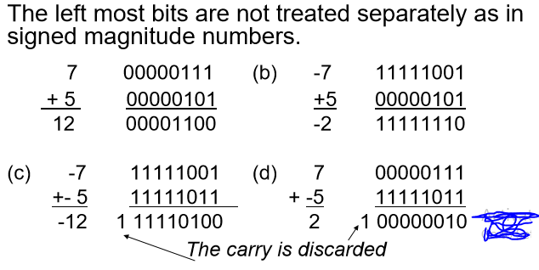
Addition of 2’s Complement Binary Integers

Slide 9
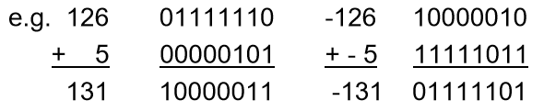
Overflow in 2’s complement
An overflow in 2’s complement occurs when:
Adding two positive numbers produces a negative result, or when adding two negative numbers produces a positive result. Adding operands of unlike signs never produces an overflow.
Notice that discarding the carry out of the most significant bit during Two's Complement addition is a normal occurrence, and does not by itself indicate overflow.

Slide 10
FLOATING POINT FORMATS
It stores numbers given in scientific notation. It is often used to handle very large and very small numbers.
It is written in the form: Fraction*base^{exponent}
e.g.0.000000357 = 0.357*10⁻⁶,
625000000 = 0.625*10⁹
The fraction part is called the significand and the exponent the characteristic

Slide 11
FLOATING POINT FORMAT
A floating point format is designated by:
The base
The number of bits reserved for the exponent
Then umber of bits reserved for the fraction
The method for storing the sign and magnitude of the exponent
The method for storing the sign and magnitude of the fraction.
The order in which the two signs and the two magnitudes are to occur.
The combination of the above factors for a given computer depends upon the designer.

Slide 12

A Typical Floating Point Format
The base chosen never appears in the format once chosen it is fixed.
The total number of bits in the FPF is N+M+2 where N = bits are reserved for the magnitude of the exponent and M = bits reserved for the magnitude of the fraction.

Slide 13
A Typical Floating Point Format
If base 2 is assumed the largest number that can be stored using a floating point format is N approximately 2²⁻¹ where N = number of bits reserved for the exponent.
If N = 7 the largest number is approximately
2¹²⁷ = 2⁷(2¹⁰)¹² = 128*10³⁶ = 10³⁸ and the smallest is 2⁻¹²⁶ = 10⁻³⁸

Slide 14
A Typical Floating Point Format
An exponent overflow is said to occur if an operation results in a number that is so large that the maximum size of the exponent is exceeded.
If the exponent is negative and the magnitude becomes too large, then an exponent underflow occurs.

Slide 15
Floating Point Numbers
If N+1 bits are reserved for the exponent and the sign, the offset or bias chosen = 2^{N} and the format is called the excess 2^{N} format
If N=7 the offset = 2⁷ = 128 = 10000000₂ and the format is called the excess 128 format.
The real exponent is obtained from the quantity by subtracting the offset.
In excess 128 format, the number 01111110 = 126 implies that the exponent = -2.
In Excess 2^{N} format a 1 in the MSB represents a positive exponent and a 0 in the MSB represents a negative exponent.

Slide 16
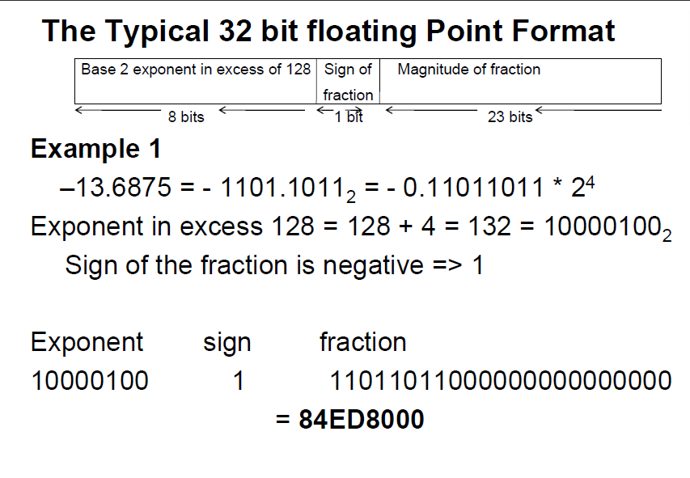

Slide 17
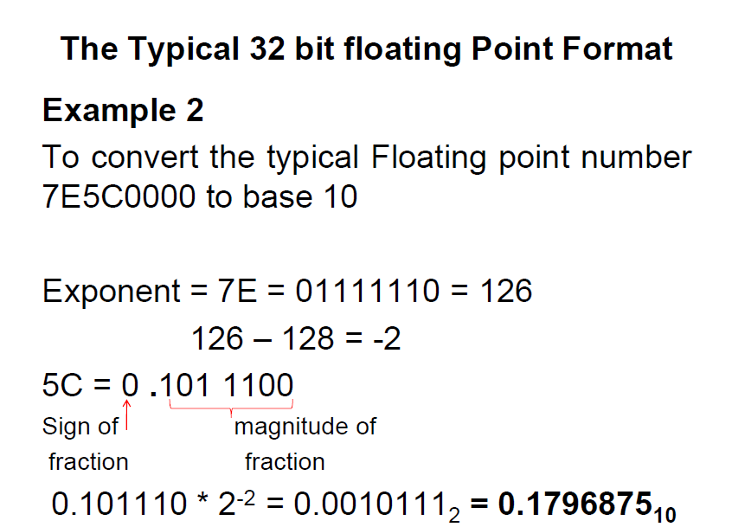

Slide 18
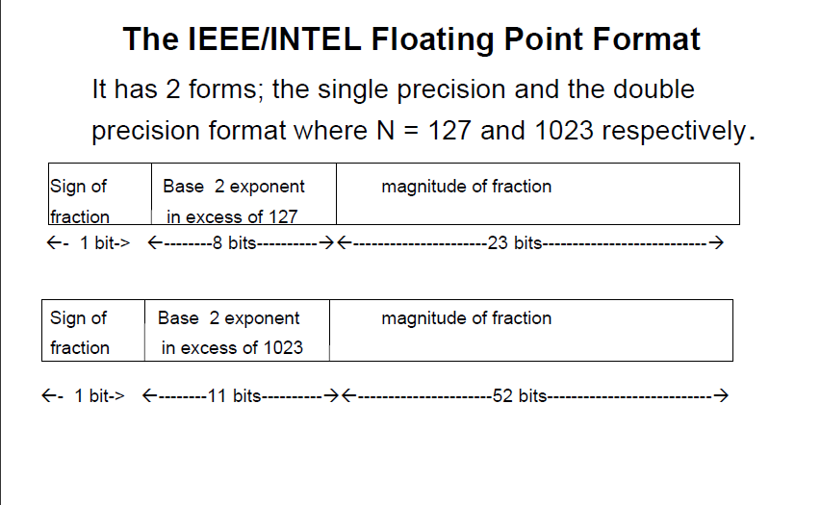

Slide 19
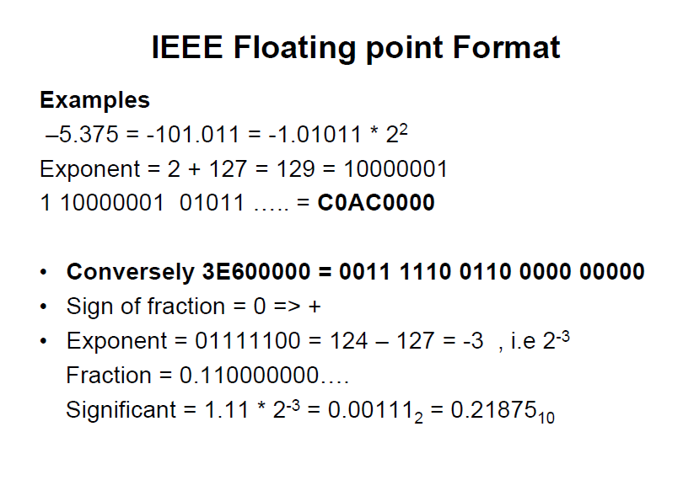

Slide 20
BINARY CODED DECIMAL
In Binary-coded decimal (BCD), each decimal digit is represented by its 4 bit binary equivalent e.g.
8159 = 1000 0001 0101 1001
There are two BCD formats.
Packed(Condensed) BCD: In this format each figure occupies half a byte e.g.
341 = 0011 0100 0001
Extended (unpacked) BCD: Each decimal figure is represented by a byte. In this case the first 4 bits of a byte can be filled with zeros or ones depending on the manufacturer ,e.g.
341 = 00000011 00000100 00000001

Slide 21
BCD
Hardware designed for BCD is more complex than that for binary formats. E.g. 16 bits are used to write 8159 in BCD while only 13 bits (1111111011111) would be required in binary.
The advantage of BCD format is that it is closer to the alphanumeric codes used for I/Os.
Numbers in text data formats must be converted from text form to binary form. Conversion is usually done by converting text input data to BCD, converting BCD to binary, do calculations then convert the result to BCD, then BCD to text output.

Slide 22
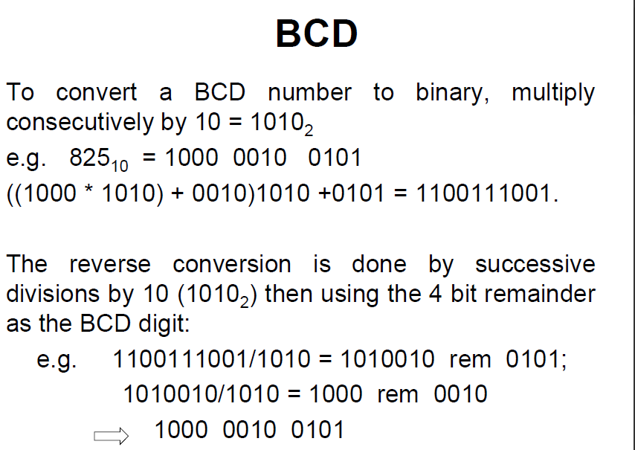

Slide 23
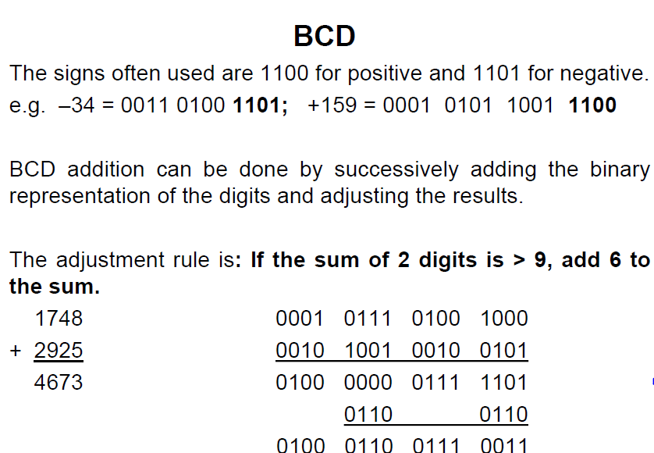

Slide 24
Non-numeric data representation
Alphanumeric codes are used when the computing device has to handle letters and special symbols as well as decimal digits.
There are three main coding methods in use:
1. The American Standard Code for Information Interchange (ASCII)
2. Extended Binary Coded Decimal Interchange Code (EBCDIC)
3. Unicode also known as Universal code.

Slide 25
Alphanumeric data
Alphanumeric (character) data such as names and addresses are represented by assigning a unique binary code or sequence of bits to represent each character.
As each character is entered from a keyboard (or other input device) it is converted into its binary code

Slide 26
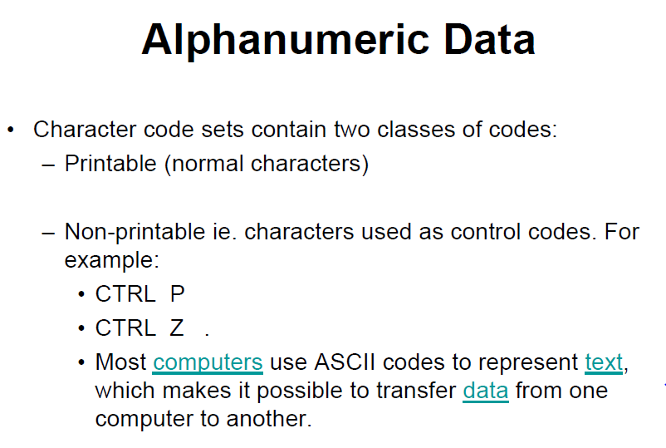

Slide 27
Alphanumeric codes - ASCII
ASCII represents each character with a 7 bit string.
The total number of characters that can be represented is 2⁷ = 128.
e.g. John = 4A 6F 68 6E
=1001010 1101111 1101000 1101110
It has an extended 8-bit version i.e Extended ASCII which supports more characters.
Used on PC’s and non-IBM mainframes
Was widely used to transfer data from one computer to another – now being replaced by Unicode.

Slide 28
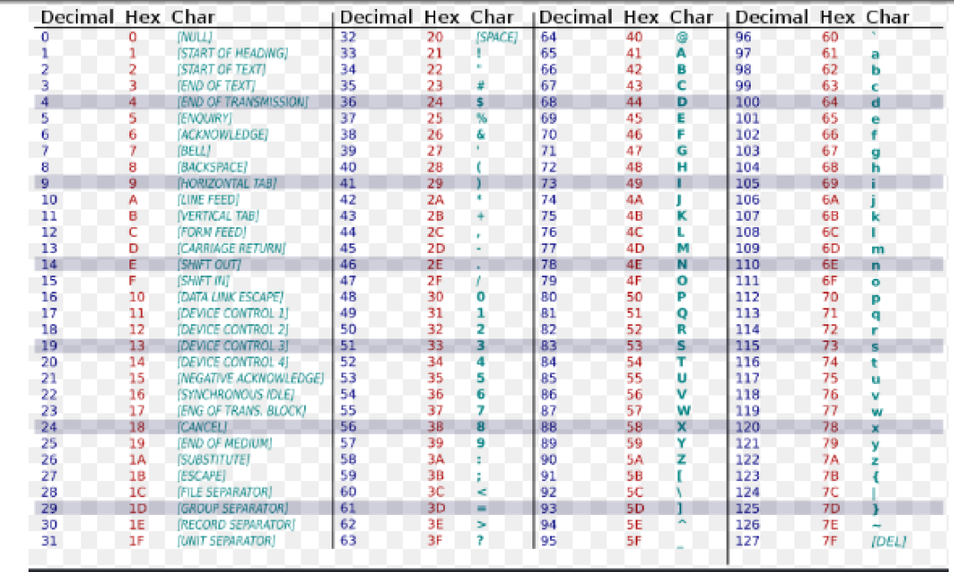
ASCII TABLE

Slide 29
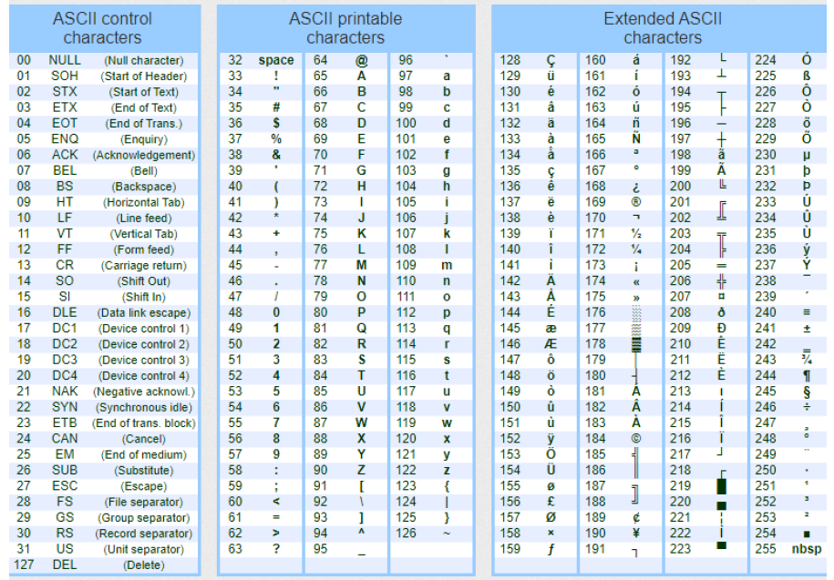
ASCII TABLE

Slide 30
Alphanumeric codes - EBCDIC
IBM invented this code to extend the Binary Coded Decimal which existed at that time.
All the IBM computers and peripherals use this code.
It is an 8 bit code and therefore can accommodate 256 characters.
NOTE:
Both ASCII and EBCDIC are inadequate for representing all international characters for example Chinese characters

Slide 31
Alphanumeric codes - Unicode
The Unicode is a 16-bit code so it can represent 65,536 different characters.
It changes as new character sets are introduced into it.
It is the most complete character encoding scheme that allows text of all forms and languages to be encoded for use by computers.
It also incorporates ASCII-7 as subset.

